Slide 1
Real-Time Implementation of ITU-T G.723.1 Standard Voice Codec on DSP chip TMS320C6713
นายธนิต นพพันธ์ 44010203
นายนริศร พงษ์พานิช 44010243
อาจารย์ที่ปรึกษา
ดร.อรฉัตร จิตต์โสภักตร์

Slide 2
หลักการและเหตุผล
สัญญาณเสียงดิจิตอลมีปริมาณข้อมูลมากซึ่งส่งผลให้ต้องใช้แบนด์วิดท์ในการส่งและจัดเก็บในปริมาณที่สูง
เทคโนโลยีการบีบอัดเสียง
  การสุ่ม-การแทนเสียงสัญญาณ
การแทนเสียงสัญญาณ

Slide 3
วัตถุประสงค์
ศึกษาหลักการการบีบอัดเสียงมาตรฐาน G.723.1
พัฒนาโปรแกรมการบีบอัดเสียงบนมาตรฐาน G.723.1 เพื่อให้สามารถตอบสนองต่อการใช้งานและมีศักยภาพในการประมวลผลมากขึ้น

Slide 4
ขอบเขตของการพัฒนา
การทำงานของโปรแกรม G.723.1 เดิม
  สามารถส่งสัญญาณเสียงออกได้เพียง 1 ช่องสัญญาณ
  สามารถทำงานได้บนเครื่องคอมพิวเตอร์เท่านั้น
ขอบเขตของโปรแกรม G.723.1 ที่ทำการพัฒนา
  ส่งสัญญาณเสียงออกได้อย่างน้อย 4 ช่องสัญญาณ
  ทำงานร่วมกับบอร์ด DSP TMS320C6713 ได้อย่างมีประสิทธิภาพ

Slide 5
การดำเนินงาน
สิ่งที่ทำในภาคการศึกษานี้
  ศึกษาการเข้าสัญญาณเสียงตามมาตรฐาน G.723.1
  ตรวจสอบความถูกต้องของการเข้ารหัสสัญญาณเสียงบนคอมพิวเตอร์
สิ่งที่จะทำในภาคการศึกษาหน้า
  ศึกษาหลักการของ TMS320 DSP/BIOS , Algorithm Standard
  นำมาใช้ร่วมกับการเข้าสัญญาณเสียงบนมาตรฐาน G.723.1
  ทำการ Optimize G.723.1 code เพื่อให้สามารถทำงานได้ 4 channels
  เขียนโปรแกรมให้เป็น library

Slide 6
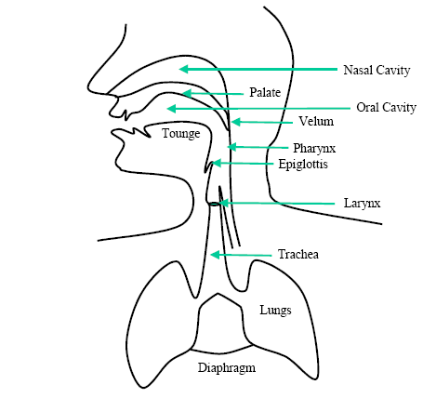
How to produce speech

Slide 7
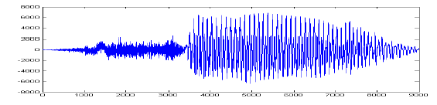
Characteristic of sound
unvoiced
voiced

Slide 8
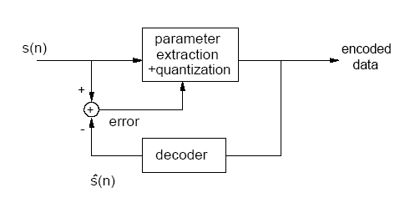
Speech Coding Principles
Analysis-by-Synthesis
  S(n) : input sound
  S(n) : synthesis sound (decoded)
^

Slide 9
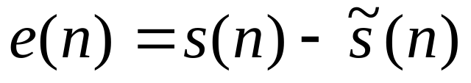
Speech Coding Principles (cont.)
Linear Prediction (LP) Concept
  To estimate current sound sample from past sound sample
  Get LP Coefficient (LPC) = a_{k} , k=1..10
  Subtract estimated sound sample from current sound sample to get error

Slide 10
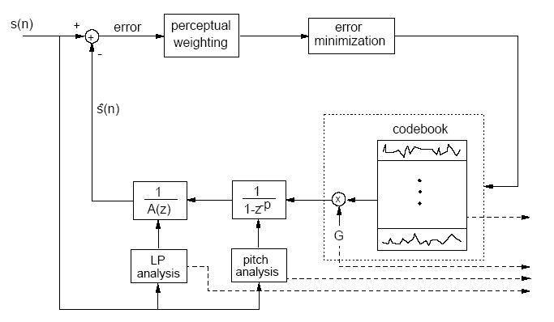
Code Excitation Linear Prediction (CELP)

Slide 11
G.723.1
Dual Rate Speech Coder For Multimedia Communications Transmitting at 5.3 and 6.3 kbit/s

Slide 12
Encoder Principles
Input
  Sampling sound at 8 kHz
  16 bit linear PCM
  Divide into frame of 240 samples
Output
  Rate 5.3 kbit/s = 20 byte per frame
  Rate 6.3 kbit/s = 24 byte per frame

Slide 13
Bit allocation of the coding algorithm
vad
LPC
indices
Adaptive
codebook
lag
All the
gain
combined
Grid
index
Pulse
position
Pulse
sign
2
24
18
48
4
48
16
Bit allocation of the 5.3 kbit/s coding algorithm
vad
LPC
indices
Adaptive
codebook
lag
All the
gain
combined
Grid
index
Pulse
position
Pulse
sign
2
24
18
48
4
73
22
Bit allocation of the 6.3 kbit/s coding algorithm

Slide 14
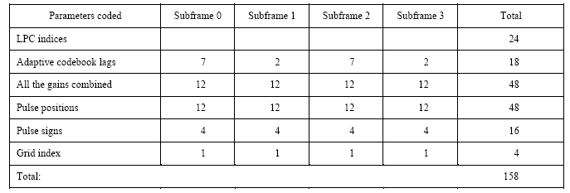
Bit allocation of 5.3 kbit/s coding algorithm

Slide 15
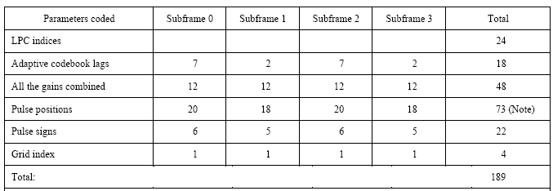
Bit allocation of 6.3 kbit/s coding algorithm

Slide 16
decoder
y[n]
LSP
Quantizer
LSP
Decoder
LSP
Interpolator
Framer
s[n]
A(z)
High Pass
Filter
S(z)
Impulse
Response
Calculator
Memory Update
W(z)
e[n]
x[n]
+
P(z)
u[n]
v[n]
LPC Analysis
A(z)
Zero input
Response
Pitch
Decoder
Excitation
Decoder
Formant
perceptual
weighting
Harmonic
Noise
Shaping
Pitch
Predictor
L_{i} ,B_{i}
-
r[n]
MP-MLQ /
ACELP
f[n]
-
t[n]
Pitch
Estimator

Slide 17
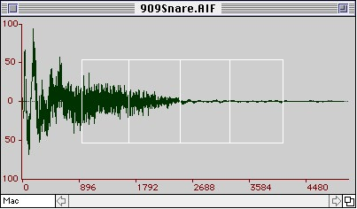
Framer
Divide into a frame of 240 sample and divide again into 4 subframes

Slide 18
decoder
y[n]
LSP
Quantizer
LSP
Decoder
LSP
Interpolator
Framer
s[n]
A(z)
High Pass
Filter
S(z)
Impulse
Response
Calculator
Memory Update
W(z)
e[n]
x[n]
+
P(z)
u[n]
v[n]
LPC Analysis
A(z)
Zero input
Response
Pitch
Decoder
Excitation
Decoder
Formant
perceptual
weighting
Harmonic
Noise
Shaping
Pitch
Predictor
L_{i} ,B_{i}
-
r[n]
MP-MLQ /
ACELP
f[n]
-
t[n]
Pitch
Estimator

Slide 19
High Pass Filter
Input : speech frame of 240 sample
Output : DC removed speech
Remove unwanted low frequency component

Slide 20
decoder
y[n]
LSP
Quantizer
LSP
Decoder
LSP
Interpolator
Framer
s[n]
A(z)
High Pass
Filter
S(z)
Impulse
Response
Calculator
Memory Update
W(z)
e[n]
x[n]
+
P(z)
u[n]
v[n]
LPC Analysis
A(z)
Zero input
Response
Pitch
Decoder
Excitation
Decoder
Formant
perceptual
weighting
Harmonic
Noise
Shaping
Pitch
Predictor
L_{i} ,B_{i}
-
r[n]
MP-MLQ /
ACELP
f[n]
-
t[n]
Pitch
Estimator

Slide 21
LPC Analysis
Input : DC removed speech (240)
Output : LPC coefficient (40)
Find LP Coefficient

Slide 22
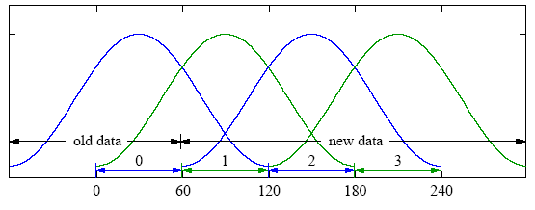
LPC Analysis
Take hamming window on 180 sample
Compute the autocorrelation
Other ten apply binomial window

Slide 23
decoder
y[n]
LSP
Quantizer
LSP
Decoder
LSP
Interpolator
Framer
s[n]
A(z)
High Pass
Filter
S(z)
Impulse
Response
Calculator
Memory Update
W(z)
e[n]
x[n]
+
P(z)
u[n]
v[n]
LPC Analysis
A(z)
Zero input
Response
Pitch
Decoder
Excitation
Decoder
Formant
perceptual
weighting
Harmonic
Noise
Shaping
Pitch
Predictor
L_{i} ,B_{i}
-
r[n]
MP-MLQ /
ACELP
f[n]
-
t[n]
Pitch
Estimator

Slide 24
LSP Quantizer
Input : LPC coefficient for sub frame 3 (10),
  LSP from previous frame (10)
Output : LSP VQ index (24)
Change from LPC to LSP
To reduce error from quantization
Quantized LSP values are sent to decoder

Slide 25
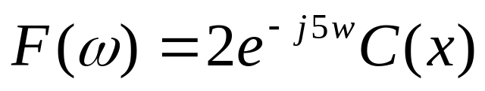
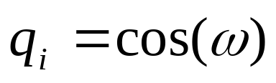
LPC to LSP

Slide 26
LPC to LSP Mapping
q_{i=1..10} = cos(ω_{i})
60 points equally spaced
between 0 and π
Checking for sign changes
and divided 4 times
ω
π
0

Slide 27
Code Book Mapping
2 bits using
compare new entry and centroy then add it
centroy can change as follow the average by a new entry
X₁Y₁
X₂Y₂
X₄Y₄
X₃Y₃

Slide 28
decoder
y[n]
LSP
Quantizer
LSP
Decoder
LSP
Interpolator
Framer
s[n]
A(z)
High Pass
Filter
S(z)
Impulse
Response
Calculator
Memory Update
W(z)
e[n]
x[n]
+
P(z)
u[n]
v[n]
LPC Analysis
A(z)
Zero input
Response
Pitch
Decoder
Excitation
Decoder
Formant
perceptual
weighting
Harmonic
Noise
Shaping
Pitch
Predictor
L_{i} ,B_{i}
-
r[n]
MP-MLQ /
ACELP
f[n]
-
t[n]
Pitch
Estimator

Slide 29
LSP Decoder
Input : 24 bit ( 3 VQ indice ) ,
previous LSP (10)
Output : quantized LSP (10)
Performs inverse vector quantization of the LSP frequencies
Divided LSP vector

Slide 30
decoder
y[n]
LSP
Quantizer
LSP
Decoder
LSP
Interpolator
Framer
s[n]
A(z)
High Pass
Filter
S(z)
Impulse
Response
Calculator
Memory Update
W(z)
e[n]
x[n]
+
P(z)
u[n]
v[n]
LPC Analysis
A(z)
Zero input
Response
Pitch
Decoder
Excitation
Decoder
Formant
perceptual
weighting
Harmonic
Noise
Shaping
Pitch
Predictor
L_{i} ,B_{i}
-
r[n]
MP-MLQ /
ACELP
f[n]
-
t[n]
Pitch
Estimator

Slide 31
LSP interpolation
Input : Quantized LSP frequencies
Output: LPC coefficients
Quantized LSP frequencies
Converts LSP frequencies to LPC coefficients

Slide 32
decoder
y[n]
LSP
Quantizer
LSP
Decoder
LSP
Interpolator
Framer
s[n]
A(z)
High Pass
Filter
S(z)
Impulse
Response
Calculator
Memory Update
W(z)
e[n]
x[n]
+
P(z)
u[n]
v[n]
LPC Analysis
A(z)
Zero input
Response
Pitch
Decoder
Excitation
Decoder
Formant
perceptual
weighting
Harmonic
Noise
Shaping
Pitch
Predictor
L_{i} ,B_{i}
-
r[n]
MP-MLQ /
ACELP
f[n]
-
t[n]
Pitch
Estimator

Slide 33
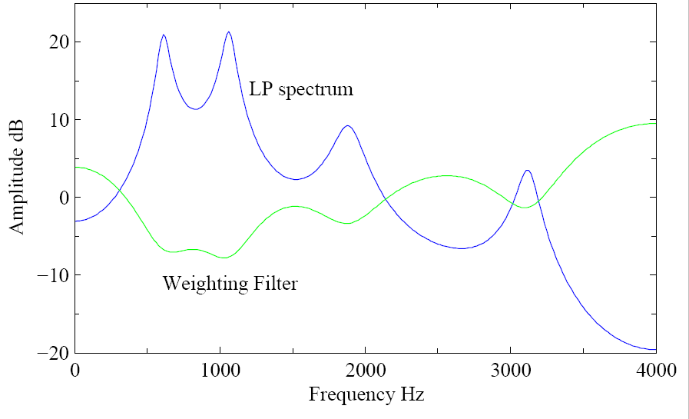
Formant perceptual weighting filter
Input : unquantized LPC (40)
Output : weight speech (240),
Perceptual weighting filter coefficients
deemphasize those regions of the spectrum in which the LP spectrum has peaks and to emphasize those regions in between peaks.

Slide 34
decoder
y[n]
LSP
Quantizer
LSP
Decoder
LSP
Interpolator
Framer
s[n]
A(z)
High Pass
Filter
S(z)
Impulse
Response
Calculator
Memory Update
W(z)
e[n]
x[n]
+
P(z)
u[n]
v[n]
LPC Analysis
A(z)
Zero input
Response
Pitch
Decoder
Excitation
Decoder
Formant
perceptual
weighting
Harmonic
Noise
Shaping
Pitch
Predictor
L_{i} ,B_{i}
-
r[n]
MP-MLQ /
ACELP
f[n]
-
t[n]
Pitch
Estimator

Slide 35
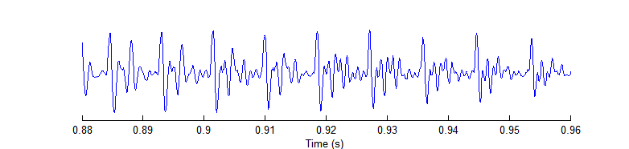
Pitch estimation
Input : perceptually weight speech
Output : Open loop pitch period
Computer every 2 sub frame
Find period with maximum energy
regular pitch periods

Slide 36
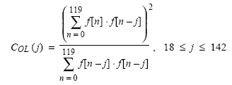
Pitch estimation
Compute by maximize term C_{OL}
F(n) : formant weighted speech sample

Slide 37
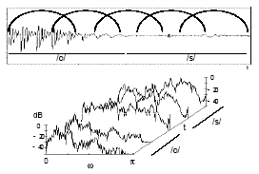
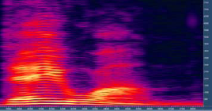
Voiced sound

Slide 38
decoder
y[n]
LSP
Quantizer
LSP
Decoder
LSP
Interpolator
Framer
s[n]
A(z)
High Pass
Filter
S(z)
Impulse
Response
Calculator
Memory Update
W(z)
e[n]
x[n]
+
P(z)
u[n]
v[n]
LPC Analysis
A(z)
Zero input
Response
Pitch
Decoder
Excitation
Decoder
Formant
perceptual
weighting
Harmonic
Noise
Shaping
Pitch
Predictor
L_{i} ,B_{i}
-
r[n]
MP-MLQ /
ACELP
f[n]
-
t[n]
Pitch
Estimator

Slide 39
Harmonic noise shaping
Input : formant perceptual speech,
Open loop pitch lag
Output : harmonic filter lag and gain ,
target vector w[n] (60)
Improve quality of encoded speech

Slide 40
decoder
y[n]
LSP
Quantizer
LSP
Decoder
LSP
Interpolator
Framer
s[n]
A(z)
High Pass
Filter
S(z)
Impulse
Response
Calculator
Memory Update
W(z)
e[n]
x[n]
+
P(z)
u[n]
v[n]
LPC Analysis
A(z)
Zero input
Response
Pitch
Decoder
Excitation
Decoder
Formant
perceptual
weighting
Harmonic
Noise
Shaping
Pitch
Predictor
L_{i} ,B_{i}
-
r[n]
MP-MLQ /
ACELP
f[n]
-
t[n]
Pitch
Estimator

Slide 41
Impulse response calculator
Input : quantized LPC,
perceptual filter coefficient,
harmonic shaping filter parameter
Output : impulse response h{n} (60)
To find characteristic of filter
Calculate impulse response of the combine filter

Slide 42

Impulse response calculator
Compute combine filter
S(z) : combine filter
A(z) : LPC synthesis filter
W(z) : formant perceptual filter
P(z) : harmonic noise filter

Slide 43
decoder
y[n]
LSP
Quantizer
LSP
Decoder
LSP
Interpolator
Framer
s[n]
A(z)
High Pass
Filter
S(z)
Impulse
Response
Calculator
Memory Update
W(z)
e[n]
x[n]
+
P(z)
u[n]
v[n]
LPC Analysis
A(z)
Zero input
Response
Pitch
Decoder
Excitation
Decoder
Formant
perceptual
weighting
Harmonic
Noise
Shaping
Pitch
Predictor
L_{i} ,B_{i}
-
r[n]
MP-MLQ /
ACELP
f[n]
-
t[n]
Pitch
Estimator

Slide 44
Zero input response and ringing subtraction
Input : target vector w[n],
quantize LPC,
perceptual filter coefficient
Output : target vector t[n] = w[n] – z[n]
find output of filter when input is all zero
Subtract from target signal to get error

Slide 45
decoder
y[n]
LSP
Quantizer
LSP
Decoder
LSP
Interpolator
Framer
s[n]
A(z)
High Pass
Filter
S(z)
Impulse
Response
Calculator
Memory Update
W(z)
e[n]
x[n]
+
P(z)
u[n]
v[n]
LPC Analysis
A(z)
Zero input
Response
Pitch
Decoder
Excitation
Decoder
Formant
perceptual
weighting
Harmonic
Noise
Shaping
Pitch
Predictor
L_{i} ,B_{i}
-
r[n]
MP-MLQ /
ACELP
f[n]
-
t[n]
Pitch
Estimator

Slide 46
Pitch predictor
Input : open loop pitch lag,
impulse response
Output : residual vector r[n],
  close loop lag , gain
Find more precise pitch of periodic component
Pitch lag and gain are sent to decoder

Slide 47
decoder
y[n]
LSP
Quantizer
LSP
Decoder
LSP
Interpolator
Framer
s[n]
A(z)
High Pass
Filter
S(z)
Impulse
Response
Calculator
Memory Update
W(z)
e[n]
x[n]
+
P(z)
u[n]
v[n]
LPC Analysis
A(z)
Zero input
Response
Pitch
Decoder
Excitation
Decoder
Formant
perceptual
weighting
Harmonic
Noise
Shaping
Pitch
Predictor
L_{i} ,B_{i}
-
r[n]
MP-MLQ /
ACELP
f[n]
-
t[n]
Pitch
Estimator

Slide 48
Excitation encoder
(MP-MLQ / ACELP)
Input : excitation parameter (gain and lag),
residual vector
Output : excitation vector,
fixed codebook parameter
Approximate the non-periodic component
Place some pulses to specify non-periodic sample

Slide 49


Excitation encoder
(MP-MLQ)
MP-MLQ ( rate 6.3 kbit/s )
  6-5 pulses per sub frame
  To estimate residual signal r[n] by r’[n] and minimize error err[n]
  G: Gain α_{k} : sign of pulse m_{k} = position

Slide 50
Excitation encoder
(ACELP)
ACELP ( rate 5.3 kbit/s )
  4 pulses per sub frame
  Minimize error to original excitation vector
sign | positions
±1 | 0,8,16,24,32,40,48,56
±1 | 2,10,18,26,34,42,50,58
±1 | 4,12,20,28,36,44,52,(60)
±1 | 6,14,22,30,38,46,54,(62)

Slide 51
decoder
y[n]
LSP
Quantizer
LSP
Decoder
LSP
Interpolator
Framer
s[n]
A(z)
High Pass
Filter
S(z)
Impulse
Response
Calculator
Memory Update
W(z)
e[n]
x[n]
+
P(z)
u[n]
v[n]
LPC Analysis
A(z)
Zero input
Response
Pitch
Decoder
Excitation
Decoder
Formant
perceptual
weighting
Harmonic
Noise
Shaping
Pitch
Predictor
L_{i} ,B_{i}
-
r[n]
MP-MLQ /
ACELP
f[n]
-
t[n]
Pitch
Estimator

Slide 52
decoder
y[n]
LSP
Quantizer
LSP
Decoder
LSP
Interpolator
Framer
s[n]
A(z)
High Pass
Filter
S(z)
Impulse
Response
Calculator
Memory Update
W(z)
e[n]
x[n]
+
P(z)
u[n]
v[n]
LPC Analysis
A(z)
Zero input
Response
Pitch
Decoder
Excitation
Decoder
Formant
perceptual
weighting
Harmonic
Noise
Shaping
Pitch
Predictor
L_{i} ,B_{i}
-
r[n]
MP-MLQ /
ACELP
f[n]
-
t[n]
Pitch
Estimator

Slide 53
Decoder Principles
Input
  LSP coefficient
  close loop lag(delay) and gain
  excitation vector and fixed codebook parameter
Output
  Reconstructed speech for better quality

Slide 54
General Decoder Blocks Diagram
e(n)
Excitation
decoder
u(n)
Synthesis
filter
q(n)
Reproduced
speech

Slide 55
General Decoder Blocks Diagram
LSP
Decoder
LSP
Interpolator
A(z)
Pitch
Decoder
u[n]
e[n]
Pitch
Postfilter
ppf[n]
Synthesis
Filter
sy[n]
Formant
PostFilter
+
pf[n]
Excitation
Decoder
Gain Scaling
unit
v[n]
q[n]

Slide 56
LSP Decoder
Input : previous LSP
Output: Quantized LSP
Performs inverse vector quantization of the LSP frequencies
Stability check

Slide 57


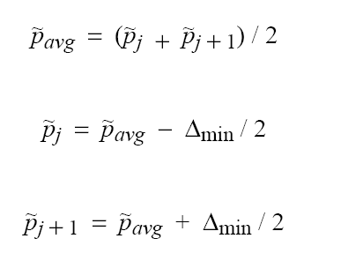
Stability check equation
= 31.25 Hz
ถ้าหากไม่เป็นไปตามสมการด้านบน

Slide 58
General Decoder Blocks Diagram
LSP
Decoder
LSP
Interpolator
A(z)
Pitch
Decoder
u[n]
e[n]
Pitch
Postfilter
ppf[n]
Synthesis
Filter
sy[n]
Formant
PostFilter
+
pf[n]
Excitation
Decoder
Gain Scaling
unit
v[n]
q[n]

Slide 59
LSP interpolation
Input : Quantized LSP frequencies
Output: LPC coefficients
Quantized LSP frequencies
Converts LSP frequencies to LPC coefficients

Slide 60
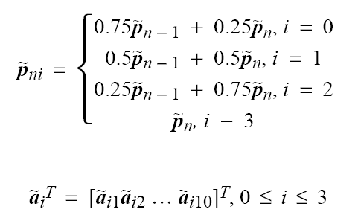
LPC convert to LPC equation

Slide 61
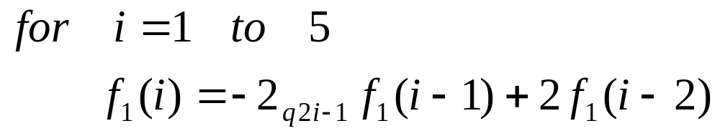
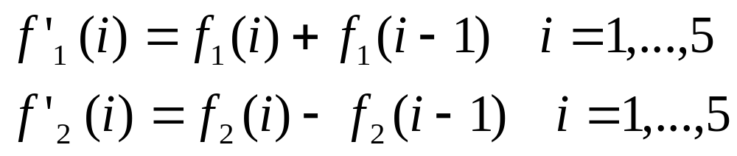
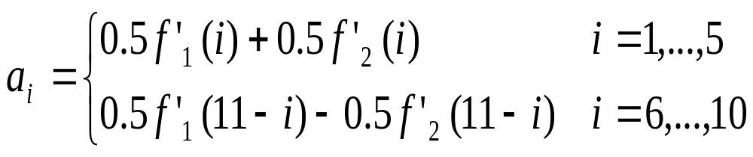
LPC convert to LPC equation (cont.)

Slide 62
General Decoder Blocks Diagram
LSP
Decoder
LSP
Interpolator
A(z)
Pitch
Decoder
u[n]
e[n]
Pitch
Postfilter
ppf[n]
Synthesis
Filter
sy[n]
Formant
PostFilter
+
pf[n]
Excitation
Decoder
Gain Scaling
unit
v[n]
q[n]

Slide 63
Decoding of the pitch information
Input : Reconstructed excitation vector
Output: Decoded reconstructed excitation vector
Computes the adaptive codebook
  Delay and gain
Reconstructed pitch contribution

Slide 64
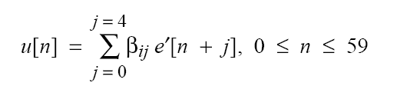
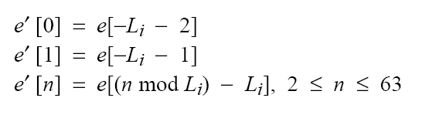
Pitch decoder equation
Low bit rate
heigh bit rate

Slide 65
General Decoder Blocks Diagram
LSP
Decoder
LSP
Interpolator
A(z)
Pitch
Decoder
u[n]
e[n]
Pitch
Postfilter
ppf[n]
Synthesis
Filter
sy[n]
Formant
PostFilter
+
pf[n]
Excitation
Decoder
Gain Scaling
unit
v[n]
q[n]

Slide 66
Excitation decoder
Input : Encoded parameters of the excitation model
Output: Decoded excitation parameters
Decoding fixed codebook excitation
  Gain , grid position and pulse sign
Reconstruct the excitation(pulse contribution)

Slide 67
Excitation decoder equation
MGIndi = GIndi – PGIndi . GSize
Grid position derived from grid bit
Pulse sign derived from sign bits

Slide 68
General Decoder Blocks Diagram
LSP
Decoder
LSP
Interpolator
A(z)
Pitch
Decoder
u[n]
e[n]
Pitch
Postfilter
ppf[n]
Synthesis
Filter
sy[n]
Formant
PostFilter
+
pf[n]
Excitation
Decoder
Gain Scaling
unit
v[n]
q[n]

Slide 69
Pitch postfilter
Input : excitation vector
Output: Pitch postfiltered excitation
Gain computation
Improve the quality of the synthesized signal (excitation signal)

Slide 70
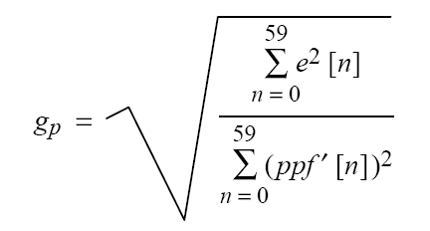
Pitch postfilter equation

Slide 71
General Decoder Blocks Diagram
LSP
Decoder
LSP
Interpolator
A(z)
Pitch
Decoder
u[n]
e[n]
Pitch
Postfilter
ppf[n]
Synthesis
Filter
sy[n]
Formant
PostFilter
+
pf[n]
Excitation
Decoder
Gain Scaling
unit
v[n]
q[n]

Slide 72
LPC synthesis filter
Input : Synthesis filter memory from previous subframe,
    LPC coefficient
Output: Synthesized speech vector ,
Updated synthesis filter memory
Synthesizes the LPC filter from LPC coefficient
Update memory
Current frame
Old frame
Current frame
Old frame

Slide 73
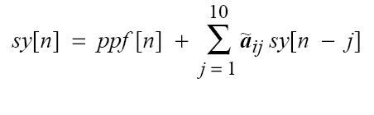
LPC synthesis filter equation

Slide 74
General Decoder Blocks Diagram
LSP
Decoder
LSP
Interpolator
A(z)
Pitch
Decoder
u[n]
e[n]
Pitch
Postfilter
ppf[n]
Synthesis
Filter
sy[n]
Formant
PostFilter
+
pf[n]
Excitation
Decoder
Gain Scaling
unit
v[n]
q[n]

Slide 75
Formant postfilter
Input :LPC coefficient,
LPC synthesized speech signal
Output: Postfiltered speech
Computes synthesized signal energy
Used to further improve the quality of the signal

Slide 76
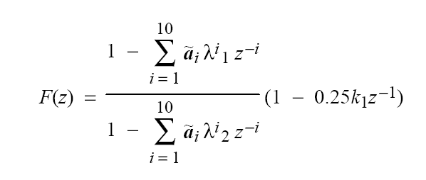
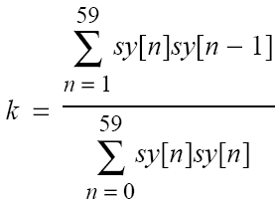

Formant postfilter equation

Slide 77
General Decoder Blocks Diagram
LSP
Decoder
LSP
Interpolator
A(z)
Pitch
Decoder
u[n]
e[n]
Pitch
Postfilter
ppf[n]
Synthesis
Filter
sy[n]
Formant
PostFilter
+
pf[n]
Excitation
Decoder
Gain Scaling
unit
v[n]
q[n]

Slide 78
Gain scaling unit
Input : synthesized speech vector,
postfiltered speech
Output: output speech signal
Postfilter gain scaling
Used for improvement of the reconstructed speech quality

Slide 79
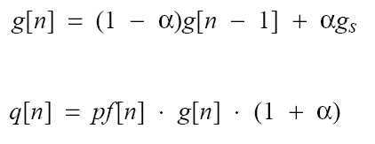
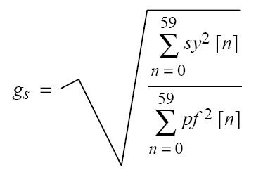

Gain scaling unit equation

Slide 80
General Decoder Blocks Diagram
LSP
Decoder
LSP
Interpolator
A(z)
Pitch
Decoder
u[n]
e[n]
Pitch
Postfilter
ppf[n]
Synthesis
Filter
sy[n]
Formant
PostFilter
+
pf[n]
Excitation
Decoder
Gain Scaling
unit
v[n]
q[n]

Slide 81
Frame interpolation handling
Bitstream for the current frame has been erasured
Voiced/unvoiced classifier
Depending on the last previous good frame
  Unvoice , the current frame is generated and scale with uniform random generator
  Voice , the current frame is regenerated with periodic excitation

Slide 82
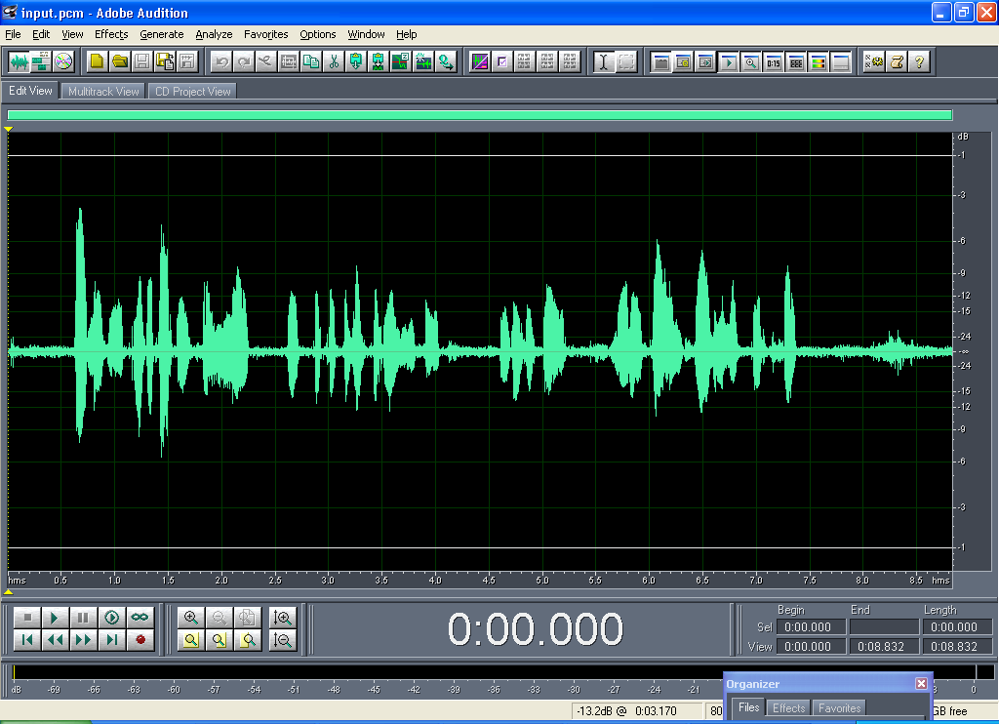
Input sound into G.723.1

Slide 83

Output from codec on PC
(rate 5.3 kbit/s)

Slide 84
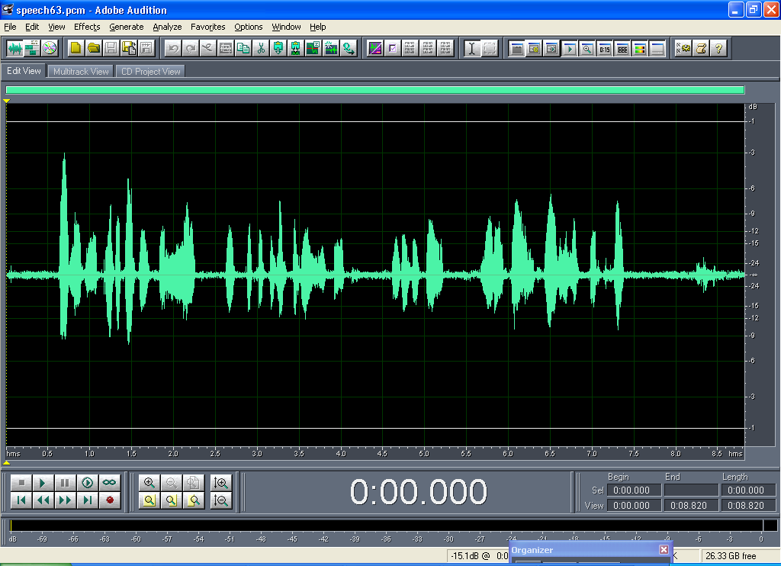
Output from codec on PC
(rate 6.3 kbit/s)

Slide 85
Compare file size on PC
Input sound size is 138 KB
Output codec file size is
Rate (kbit/s) | Encode (KB) | Decode (KB)
5.3 | 5.08 | 137
6.3 | 6.09 | 137

Slide 86
Codec on DSP Board
เปรียบเทียบผลที่ได้จากการ codec บน PC กับบน DSP board
  สัญญาณเสียง output ที่ได้มีความแตกต่างเพียงเล็กน้อย สามารถฟังเสียงได้ชัดเจน รู้เรื่อง
File size ที่ได้มีขนาดเท่ากับการทำ codec บน PC

Slide 87
Code Composer Complier Optimization
Speed level | Optimize level | Rate 5.3 kbit/s
 |  | Max | Avg | Frame | MIPs
Speed more | Function(-o2) | 8.26 | 5.87 | 2899 | 1.8585
Speed more | File(-o3) | 8.24 | 5.80 | 2274 | 1.854
Speed most | Function(-o2) | 8.06 | 5.80 | 2634 | 1.8135
Speed most | File(-o3) | 8.28 | 5.86 | 2770 | 1.863
Rate 6.3 kbit/s also select these options

Slide 88
Conclusion
1st semester
  Algorithm G.723.1 knowledge
  PC processing
  DSP board using
  DSP board processing
  Complier optimization

Slide 89
Conclusion (cont.)
2nd semester
  Multichannel
  Standard algorithm
  Make to library
  Algorithm Optimization
  Check algorithm processing

Slide 90
Q&A

